Slide 1
…
Joren Janzing

Slide 2
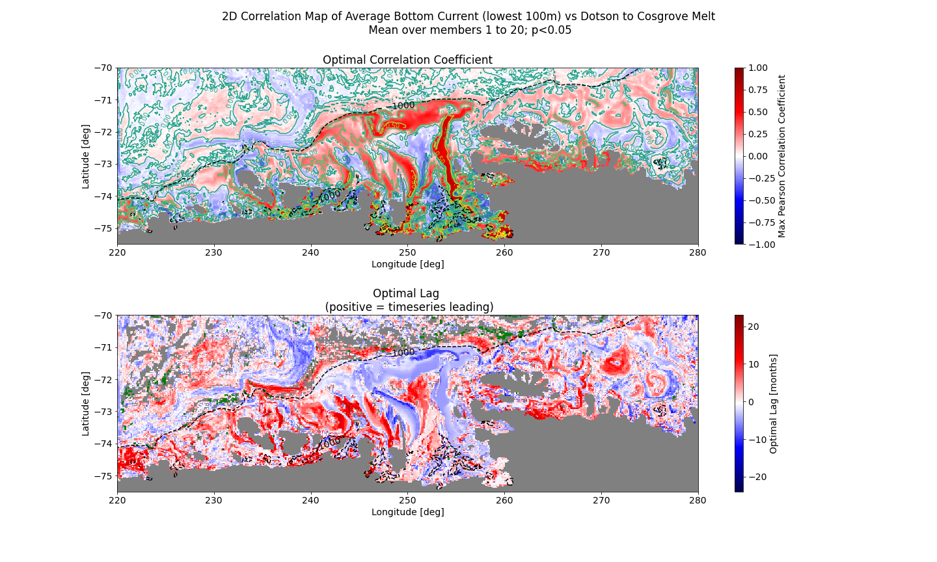
1 month rolling mean

Slide 3
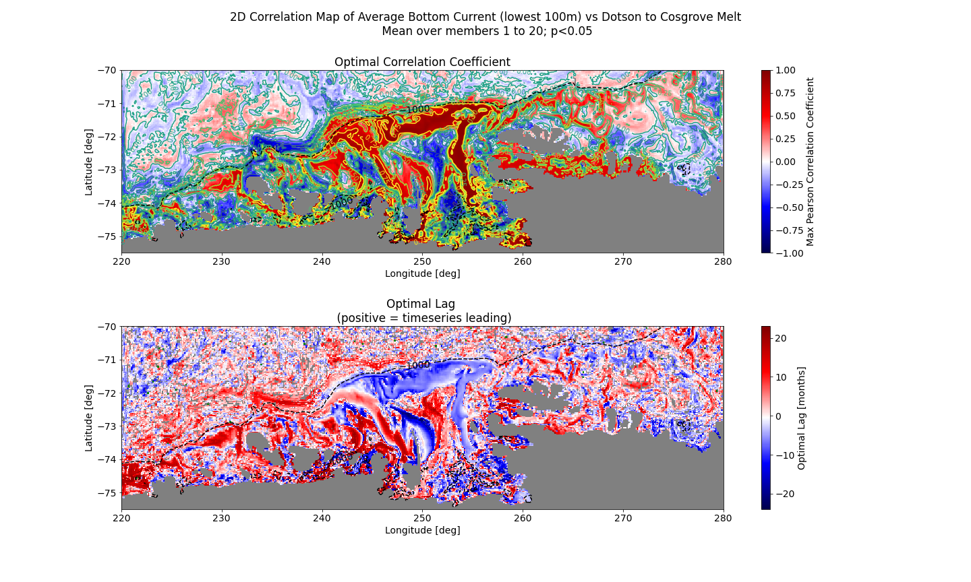
60 month rolling mean

Slide 4
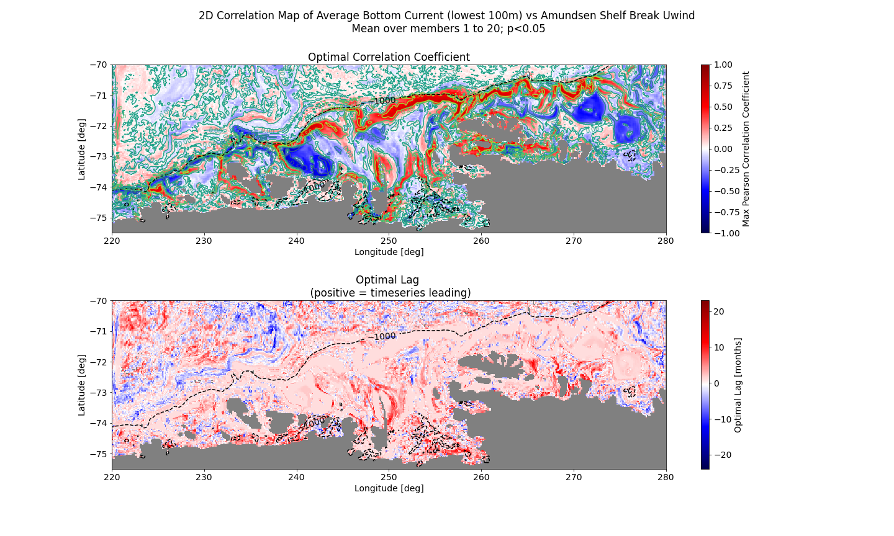
1 month rolling mean

Slide 5
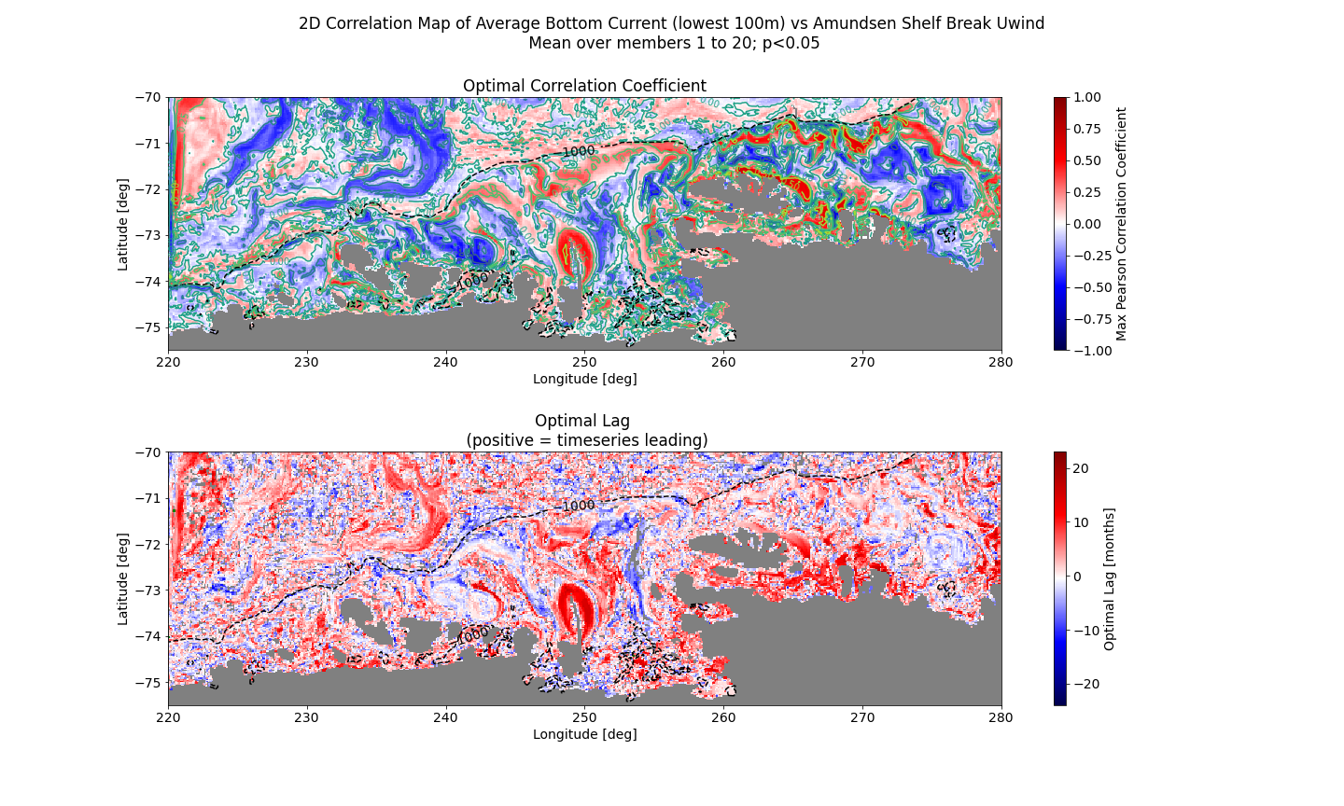
60 month rolling mean

Slide 6
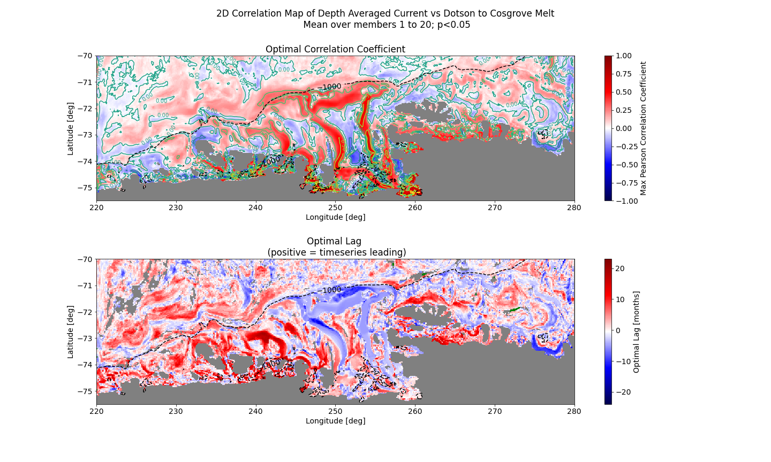
1 month rolling mean

Slide 7
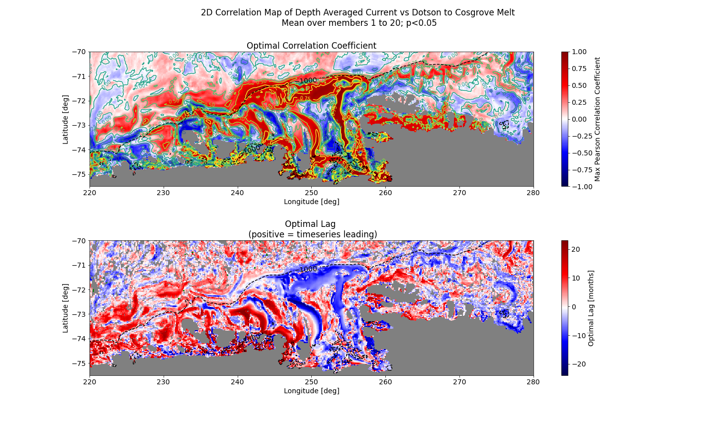
60 month rolling mean

Slide 8
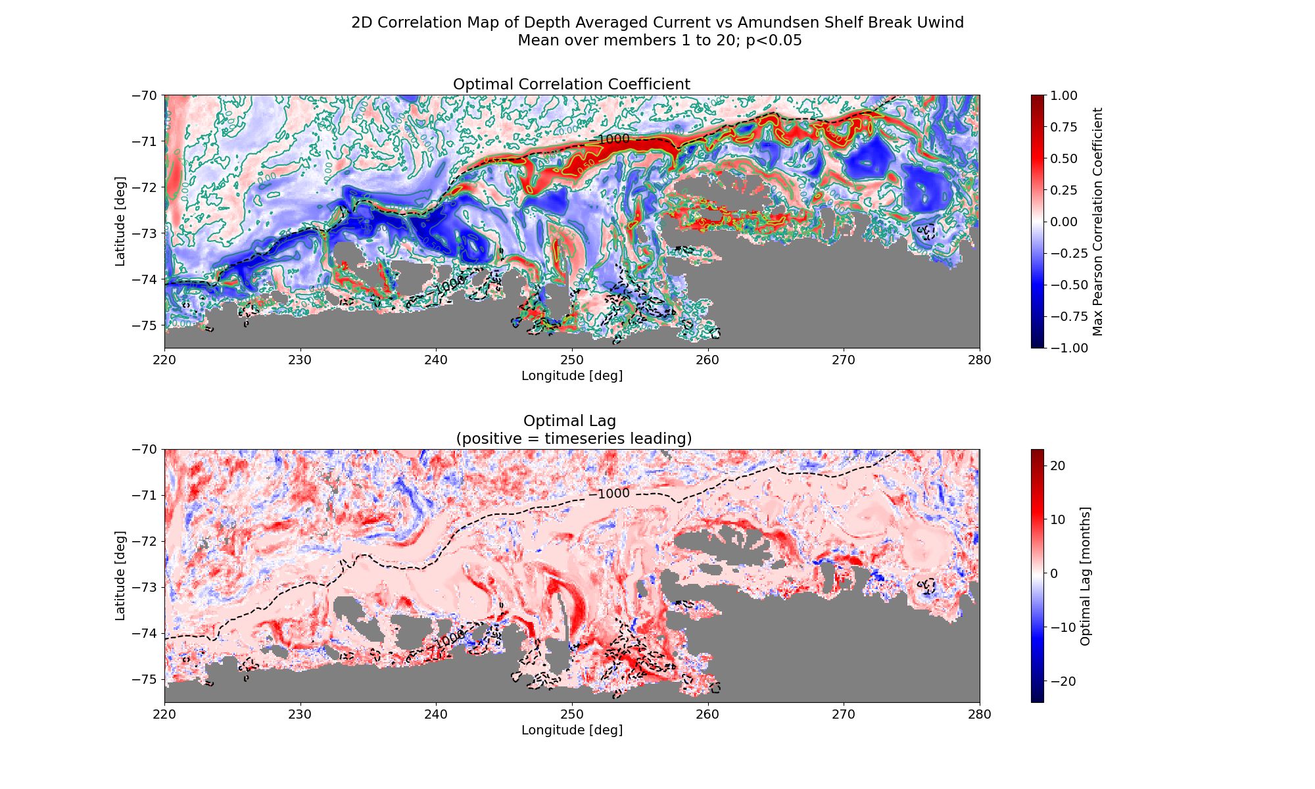
1 month rolling mean

Slide 9
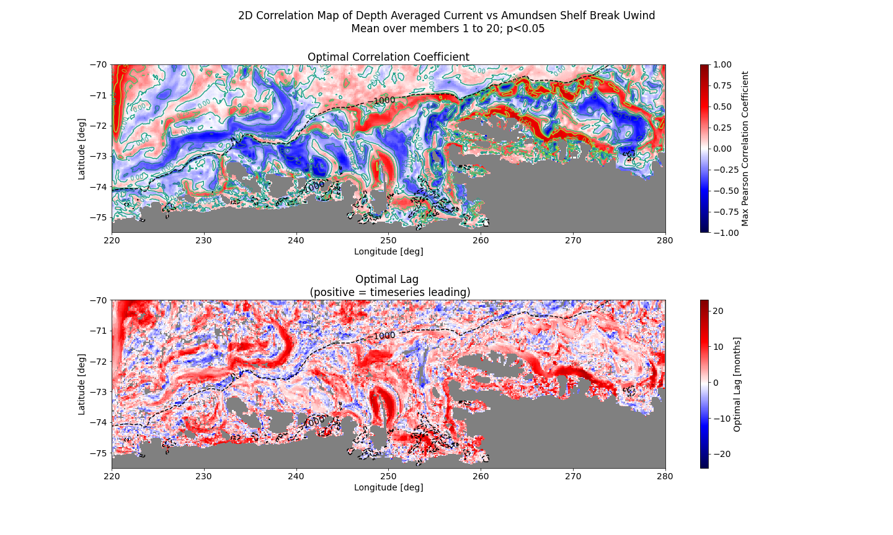
60 month rolling mean

Slide 10
